Slide 1
Referral
Referral is just a written order from your Primary care provider(PCP) for you to see a specialist or get certain medical services. A patient referral is a communication from one healthcare professional to another – usually a specialist of some kind – requesting that they accept you as a patient to evaluate your condition, provide a diagnosis, and/or provide treatment.

Slide 2
What does a referral do?
A referral provides information about you and your condition so that:
The person you are being referred to does not have to ask so many questions.
They are aware of relevant background information.
They know exactly what they are being asked to do.
A referral is also used to indicate that the consultation or test you are being referred for is clinically important, and that your insurance should cover at least part of the cost.

Slide 3
When might I need a referral?
They believe you need expertise that the other person has.
They believe you need treatment that the other person can give.
They believe you need specialized tests or investigations.
For example, someone with pregnancy complications may be referred to an obstetrician, or a person with cancer may be referred to an oncologist.

Slide 4
What information does a referral include?
Relevant clinical information
The date of the referral
The signature of the referring provider

Slide 5
How do I get a referral?
Make an appointment with your PCP or doctor and ask them to write you a referral. You can discuss your needs with them, and they can properly assess you.
This helps to ensure that the referral contains the information the other health practitioner needs.

Slide 6
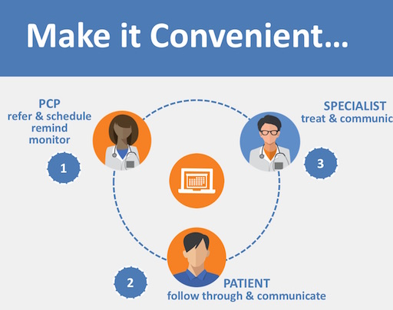
Referral in the US healthcare system refers to the process of referring a patient from one healthcare provider to another healthcare provider for further evaluation, treatment, or medical care. A referral may be required when a patient requires medical care beyond the scope of practice of the original healthcare provider, or when a patient requires specialized care that the original healthcare provider is unable to provide.

Slide 7
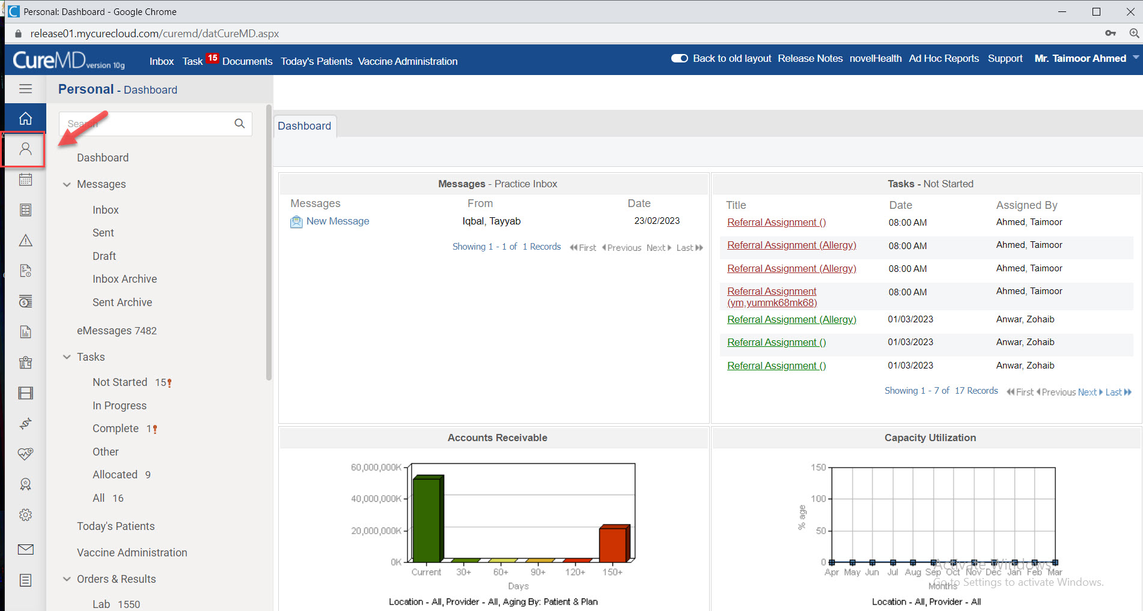
Referral Workflow

Slide 8
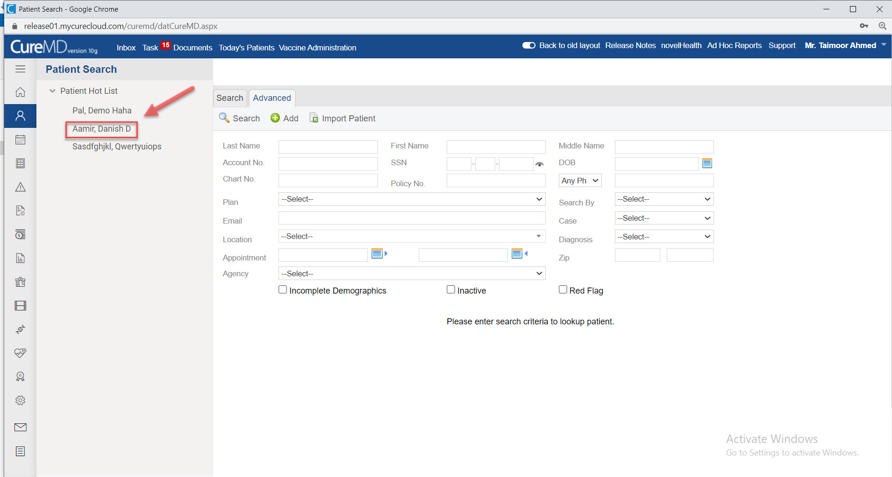
Select the Patient

Slide 9
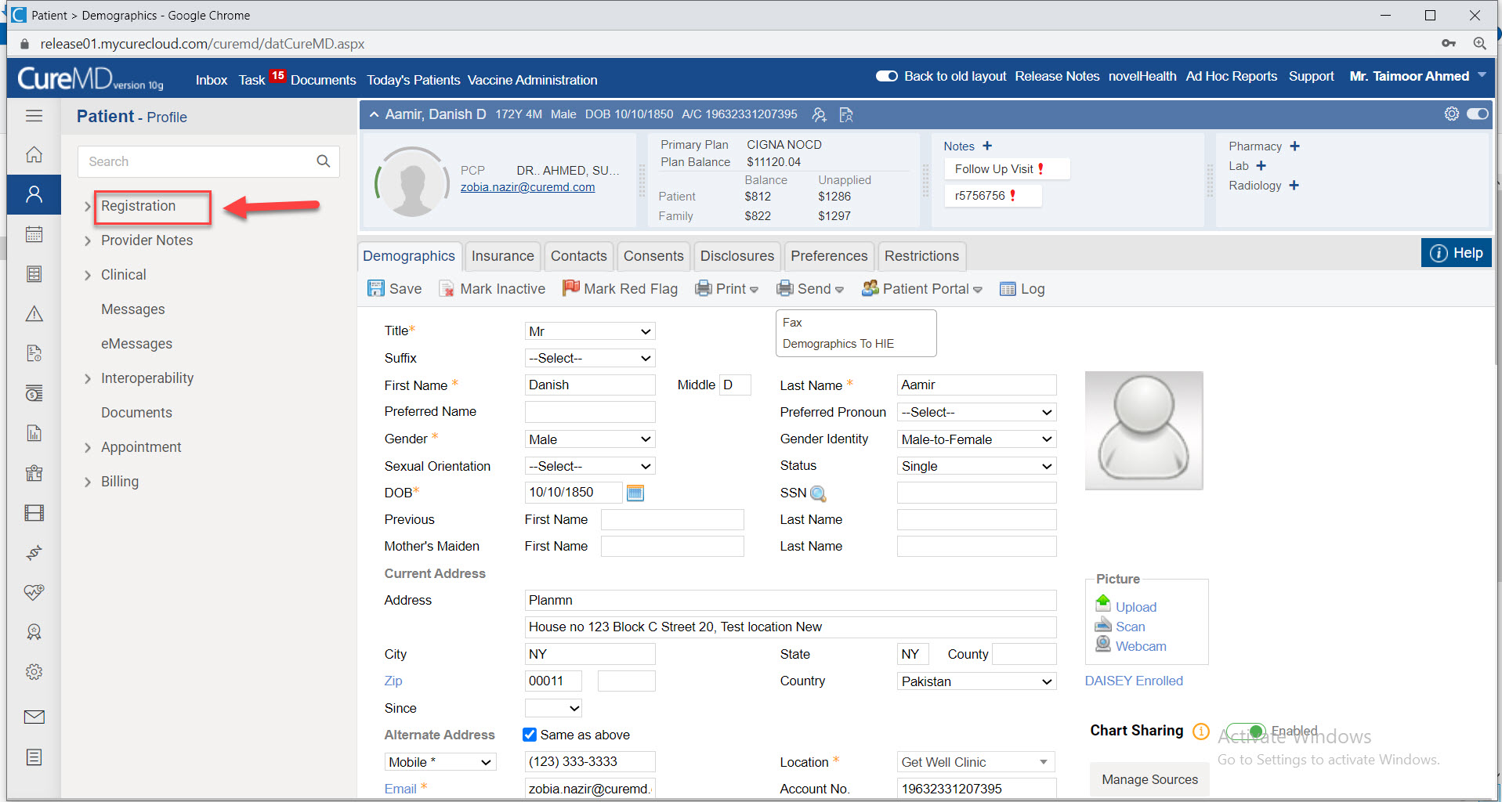
Then click on Registration

Slide 10
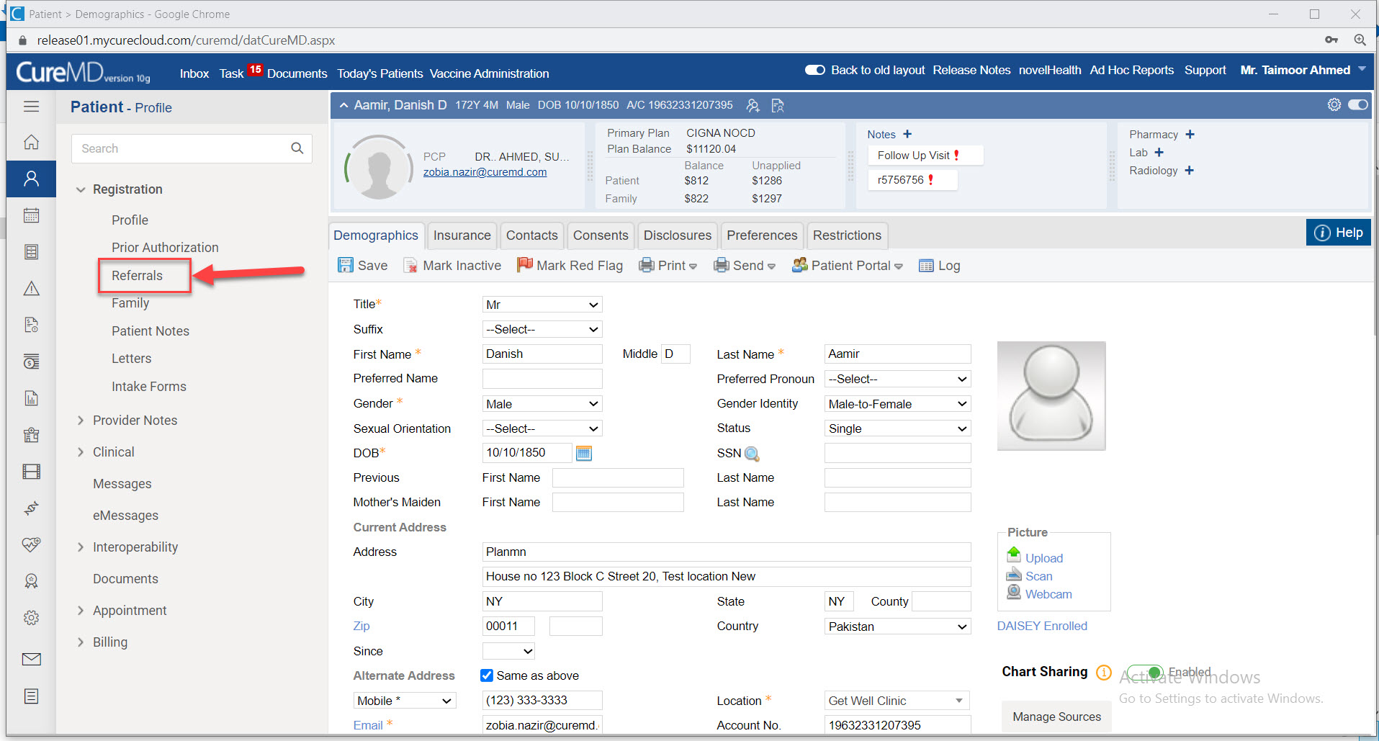
Select Referrals from the dropdown

Slide 11
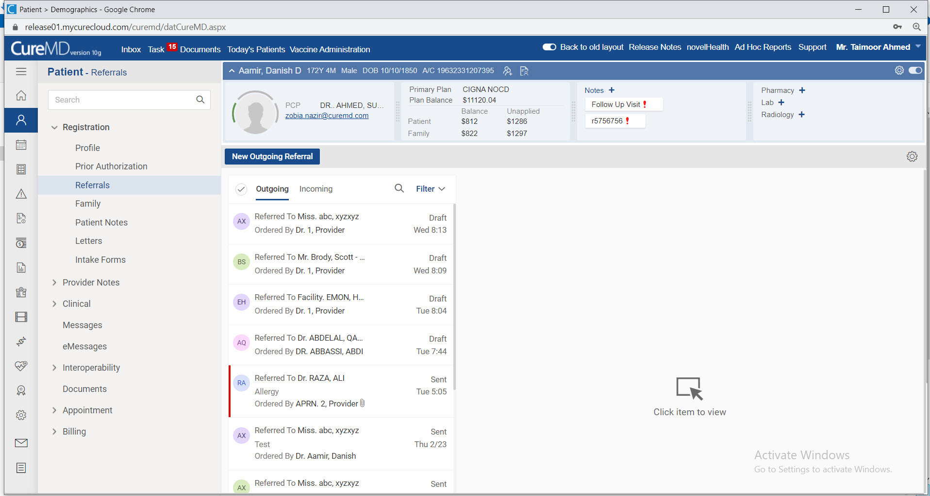
Referral window is showing

Slide 12
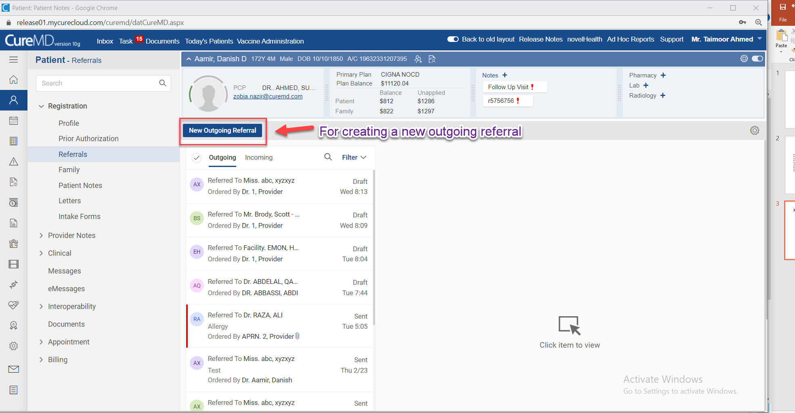
Click on any referral and if there is no referral then click on New Outgoing Referral

Slide 13
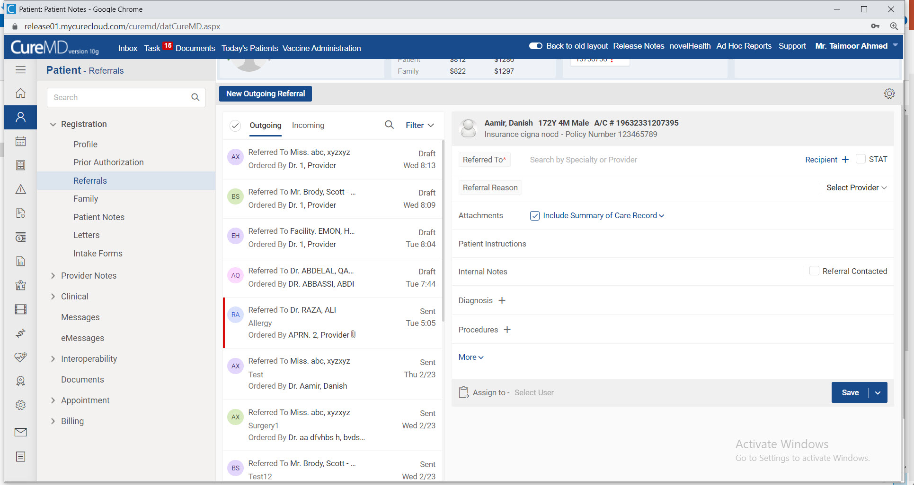
After clicking on new outgoing referral, following tab is showing

Slide 14
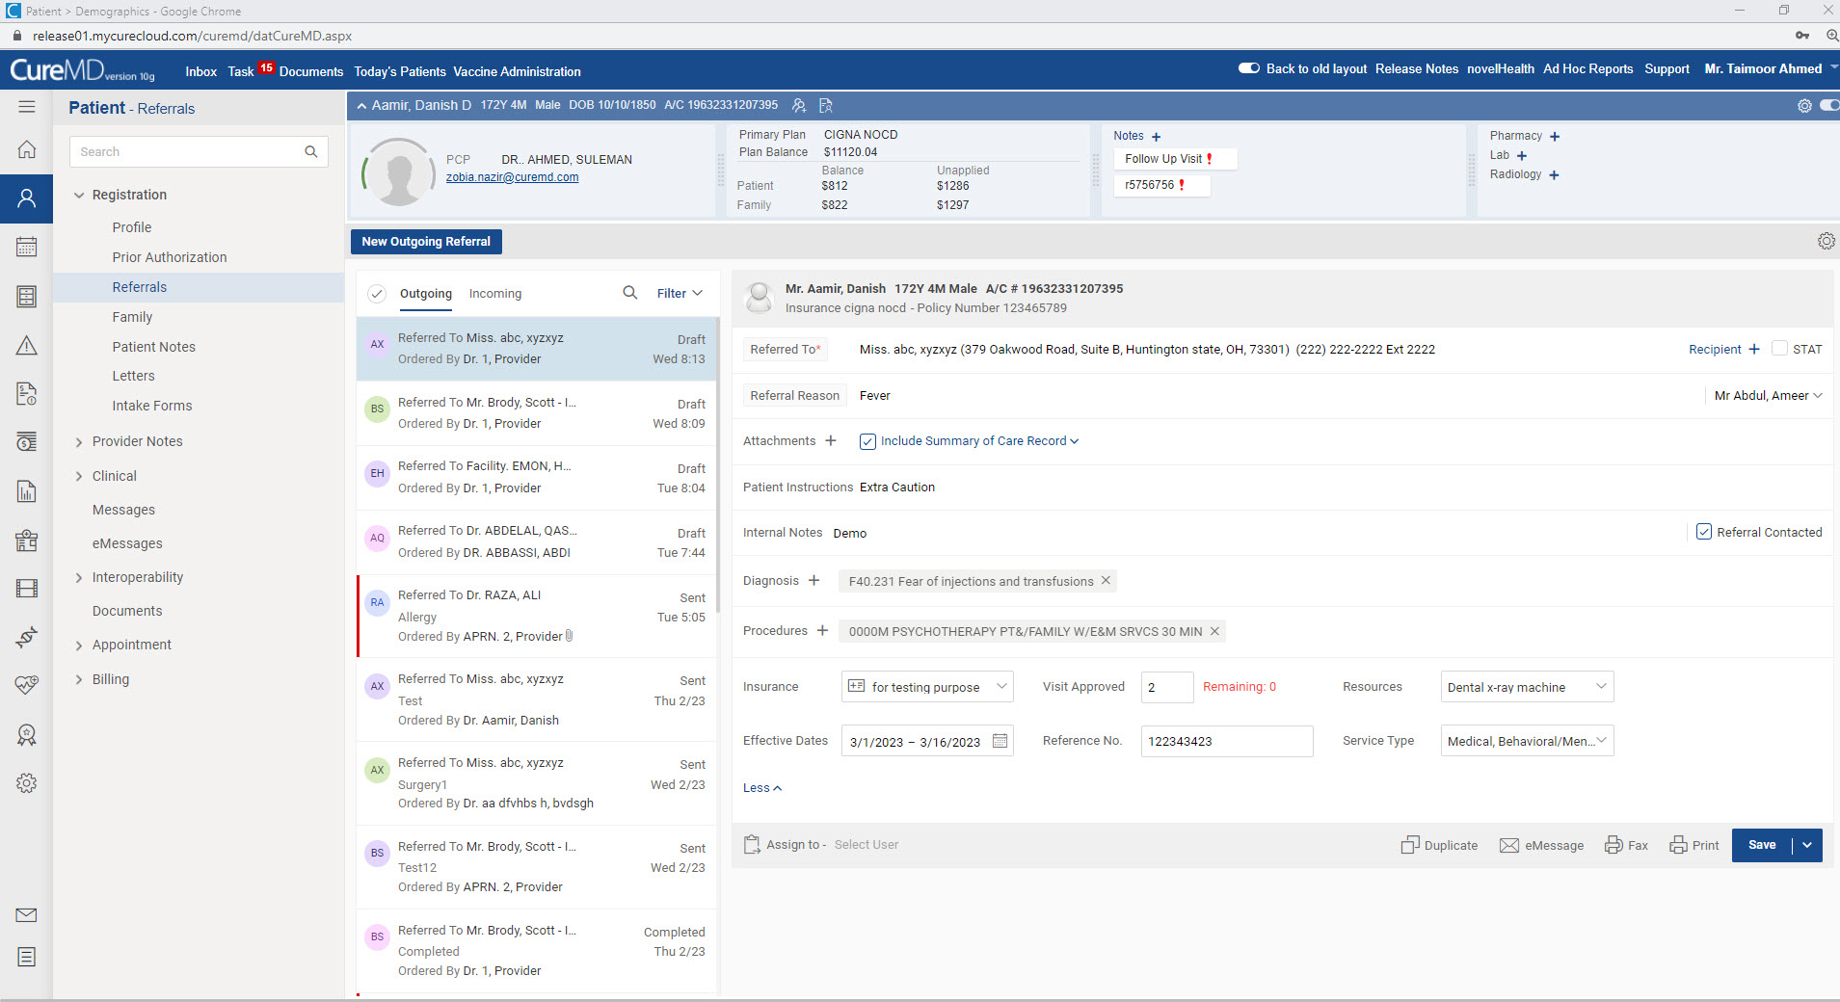
Enter the details in following fields for creating new outgoing referral

Slide 15
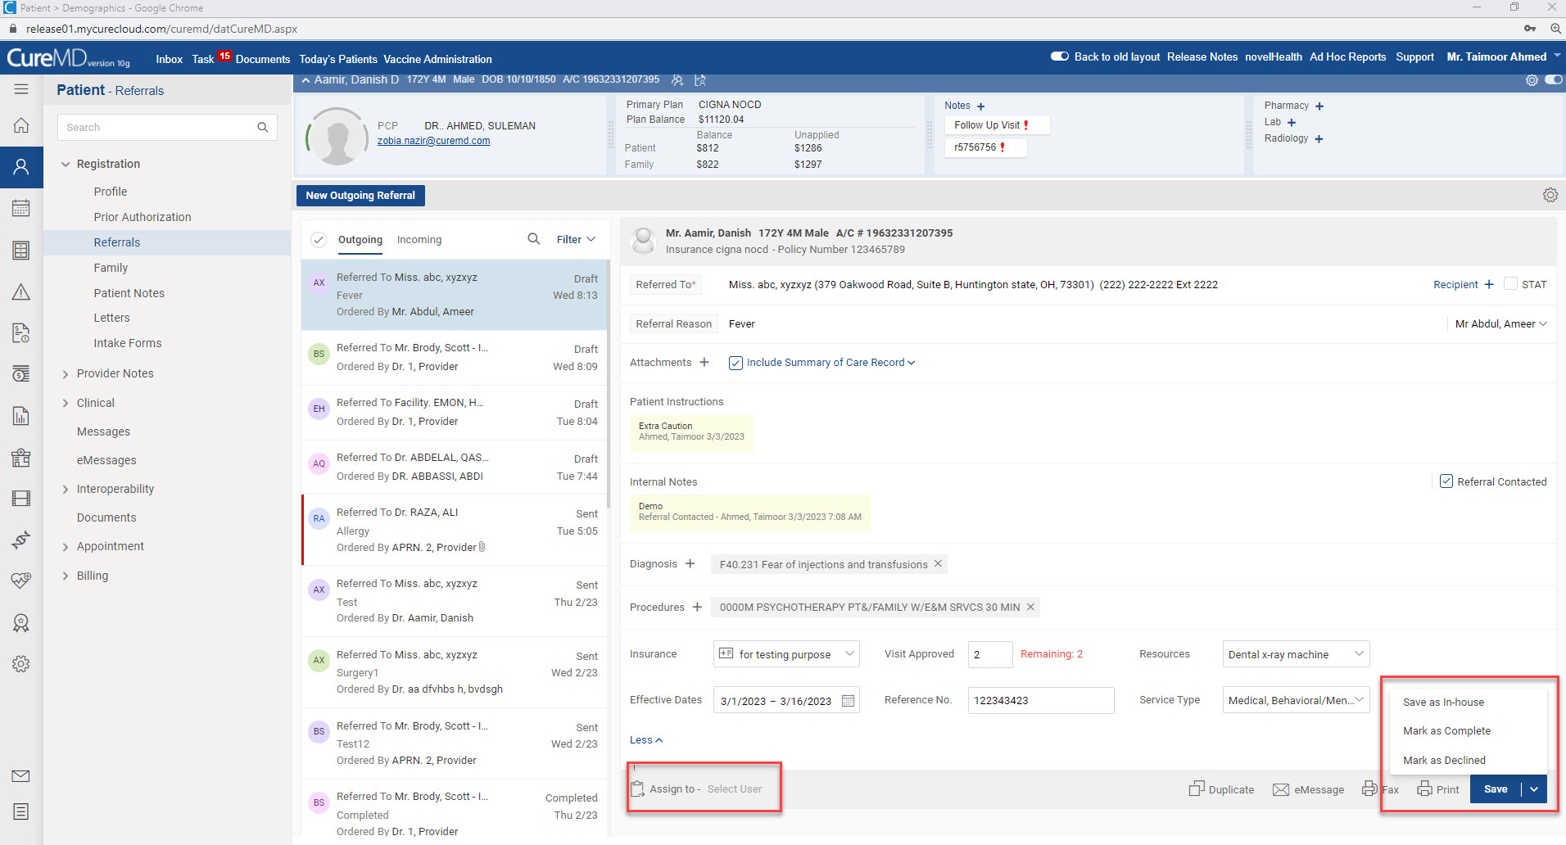
Following are the referral statuses and user which are assigned to are shown

Slide 16
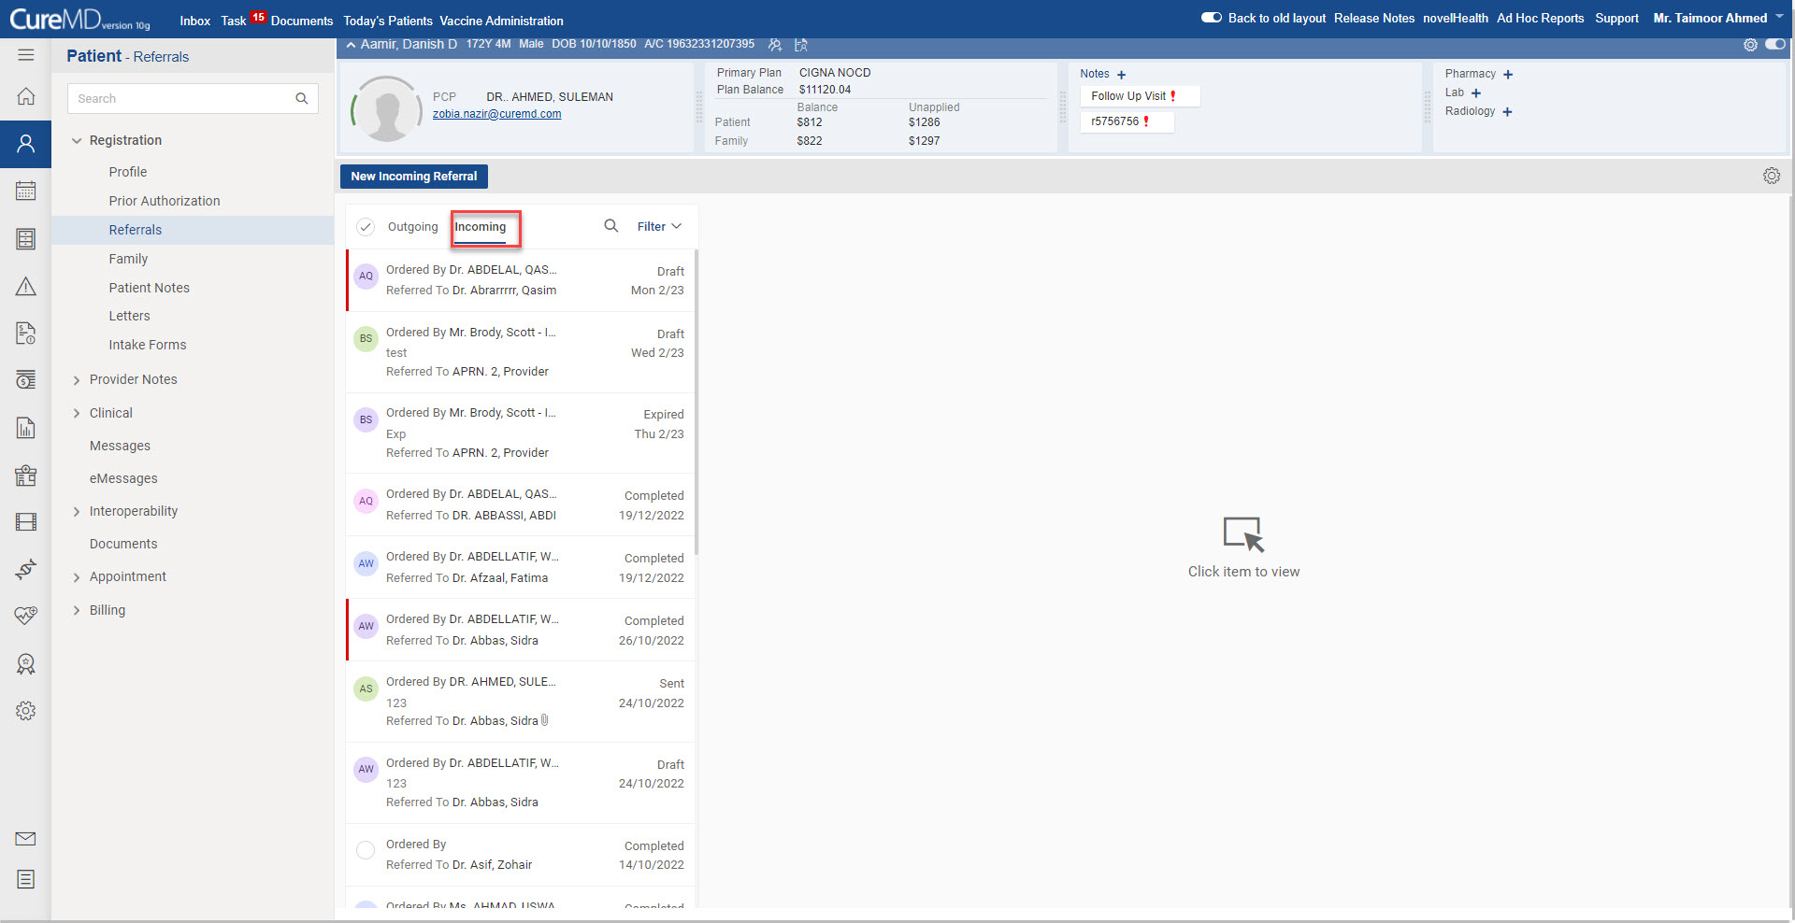
Click on any referral and if there is no referral then click on New Incoming Referral

Slide 17
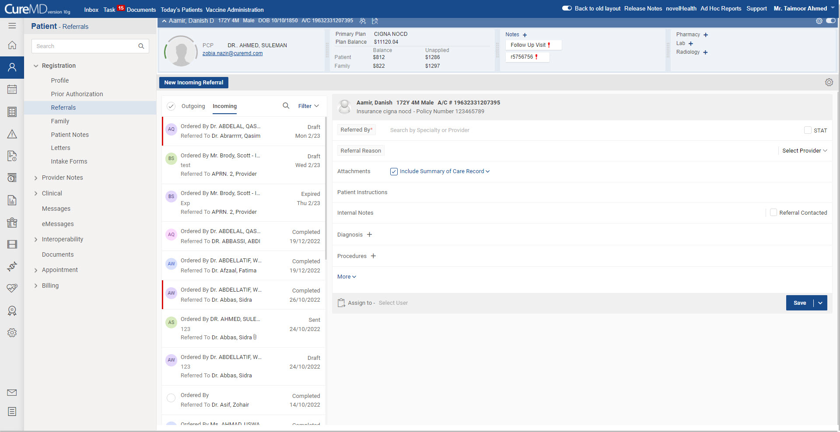
After clicking on new incoming referral, following tab is showing

Slide 18
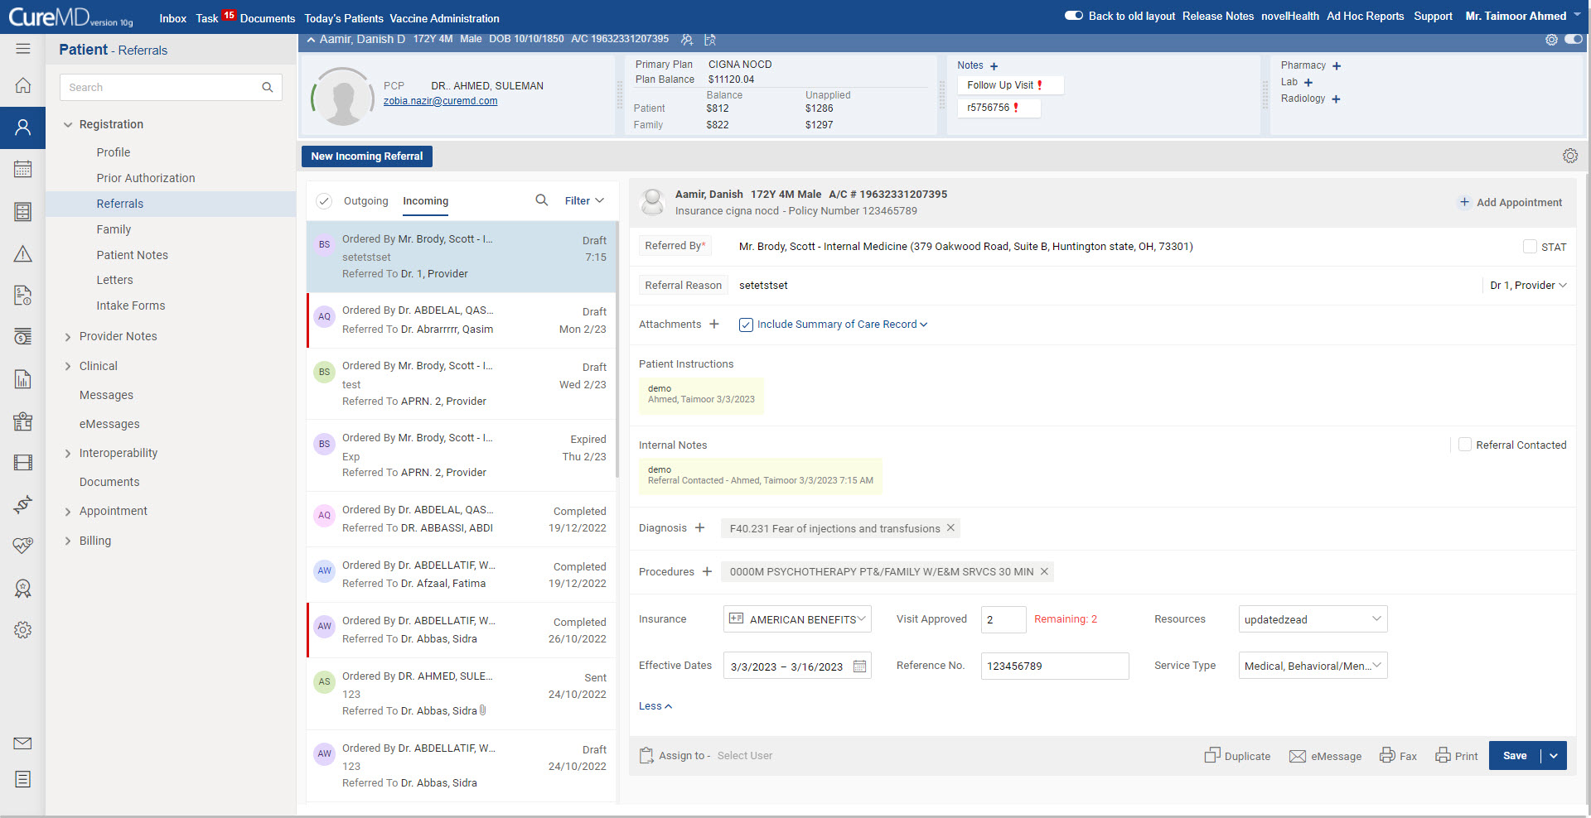
Enter the details in following fields for creating new incoming referral

